Slide 1
HNDIT2401 Computer Architecture
Week 1: Introduction and Logic gates

Slide 2
Module Code | HNDIT24012 |  | Module Title | Computer Architecture
Credits | 2 |  |  | Lectures | 1
 |  |  | Hours
GPA/NGPA |  | GPA |  | Lab/Tutorial | 2
Semester |  | 4 | Module Type | Compulsory

Slide 3
Assessment and Weighting
Assignments and tutorials 50%
Structured Paper 50%

Slide 4
The Digital Computer
The main components of a digital computer are : Input devices (keyboard, mouse, etc).
Memory board.
Central Processing Unit (processor).
Output devices (video terminal, printer, etc.).

Slide 5
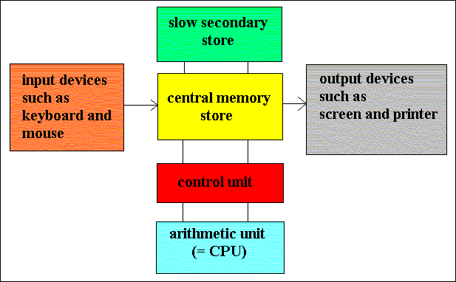
The Digital Computer
Von Neumann's computer architecture

Slide 6
Logic Gates
Digital Computers generated with many digital circuits.
Gates are combined into circuits to perform more complicated tasks.
A Logic gate is a device that performs a basic operation on electrical signals

Slide 7
Gates
Let’s examine the processing of the following six types of gates
NOT
AND
OR
XOR
NAND
NOR

Slide 8
Describing Gates and Circuits
There are three different, but equally powerful, notational methods for describing the behavior of gates and circuits
Boolean expressions
logic diagrams
truth tables

Slide 9
Describing Gates and Circuits
Boolean algebra: expressions in this algebraic notation are an elegant and powerful way to demonstrate the activity of electrical circuits
Basic propositional statements are unambiguously either True or False
Operations such as AND or NOT are then performed on these values
A gate is simply a mechanical way to perform such a boolean operation

Slide 10
Describing Gates and Circuits
Logic diagram: a graphical representation of a circuit
Each type of gate is represented by a specific graphical symbol
Truth table: defines the function of a gate by listing all possible input combinations that the gate could encounter, and the corresponding output

Slide 11
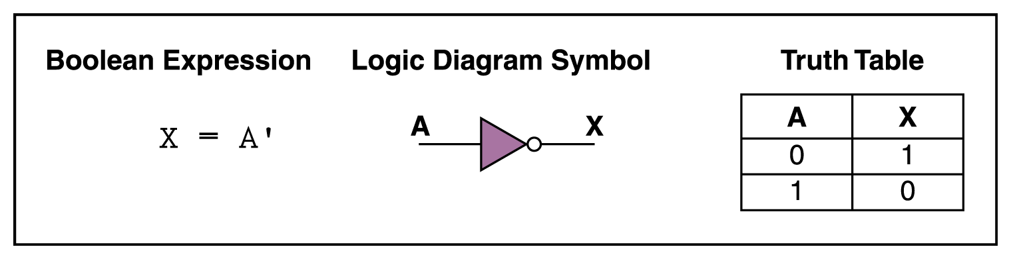
NOT Gate
a NOT gate accepts one input value and produces one output value
a NOT gate is sometimes referred to as an inverter because it inverts the input value

Slide 12
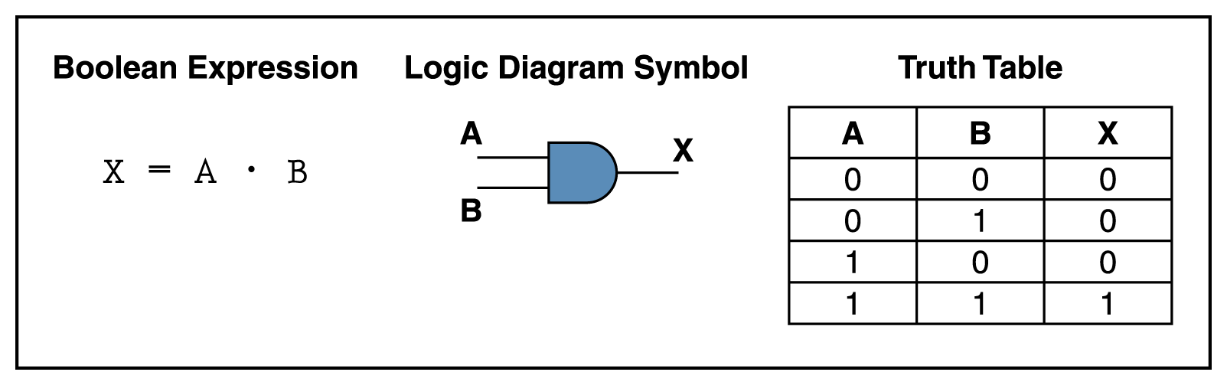
AND Gate
An AND gate accepts two input signals
If the two input values for an AND gate are both 1, the output is 1; otherwise, the output is 0
Figure 4.2 Various representations of an AND gate

Slide 13
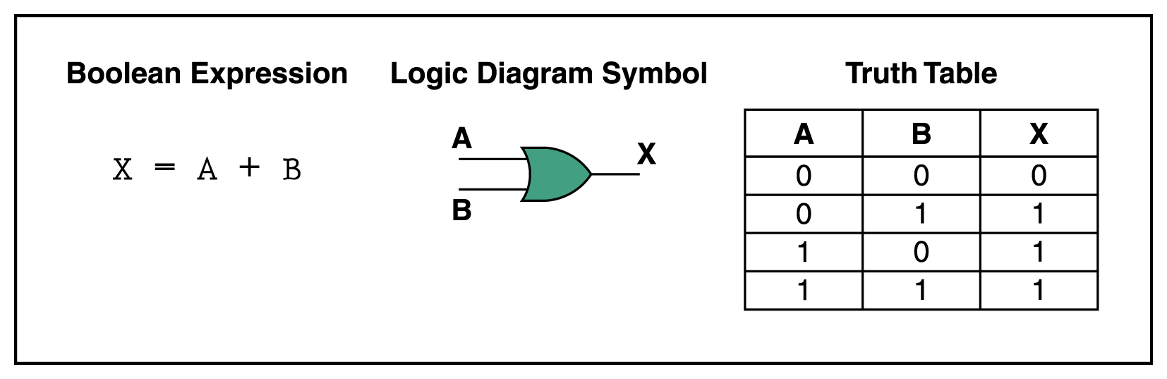
OR Gate
If the two input values are both 0, the output value is 0; otherwise, the output is 1
Figure 4.3 Various representations of a OR gate

Slide 14
XOR Gate
XOR, or exclusive OR, gate
An XOR gate produces 0 if its two inputs are the same, and a 1 otherwise
Note the difference between the XOR gate and the OR gate; they differ only in one input situation
When both input signals are 1, the OR gate produces a 1 and the XOR produces a 0

Slide 15
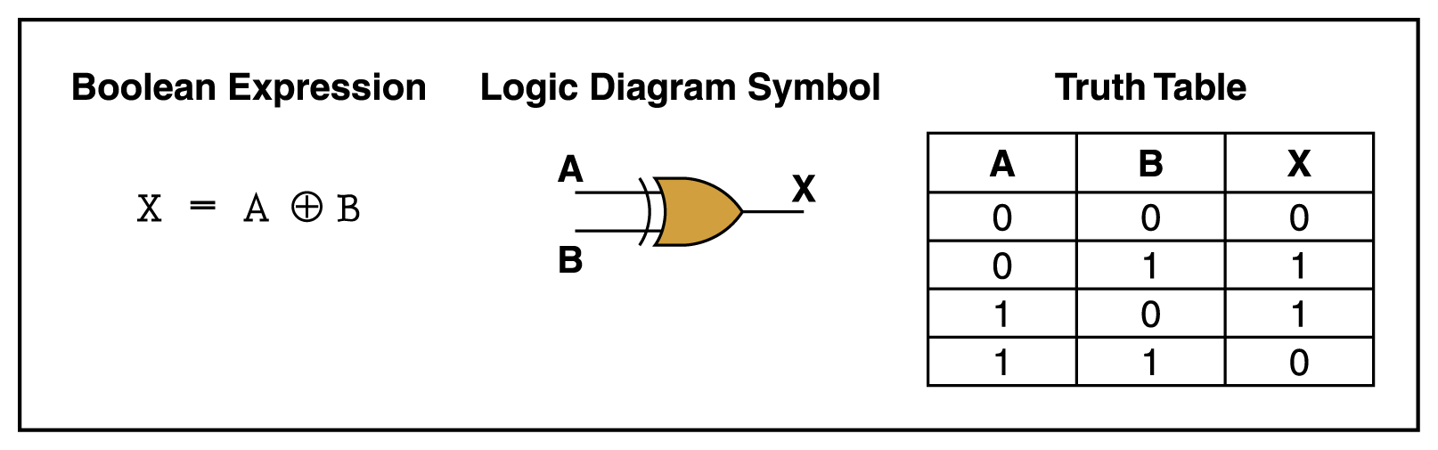
XOR Gate
Figure 4.4 Various representations of an XOR gate

Slide 16
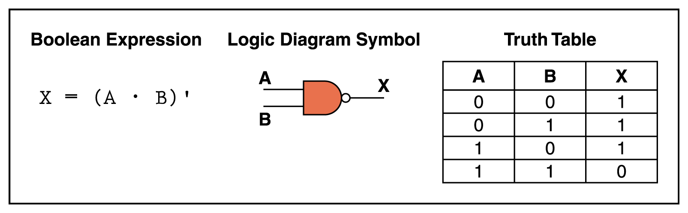
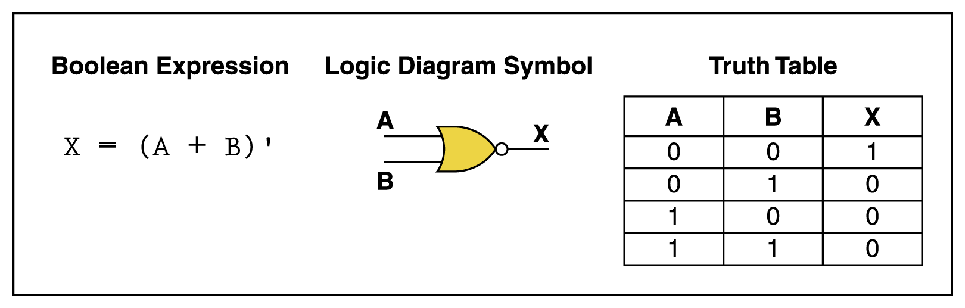
NAND and NOR Gates
The NAND and NOR gates are essentially the opposite of the AND and OR gates, respectively
Figure 4.5 Various representations of a NAND gate
Figure 4.6 Various representations of a NOR gate

Slide 17
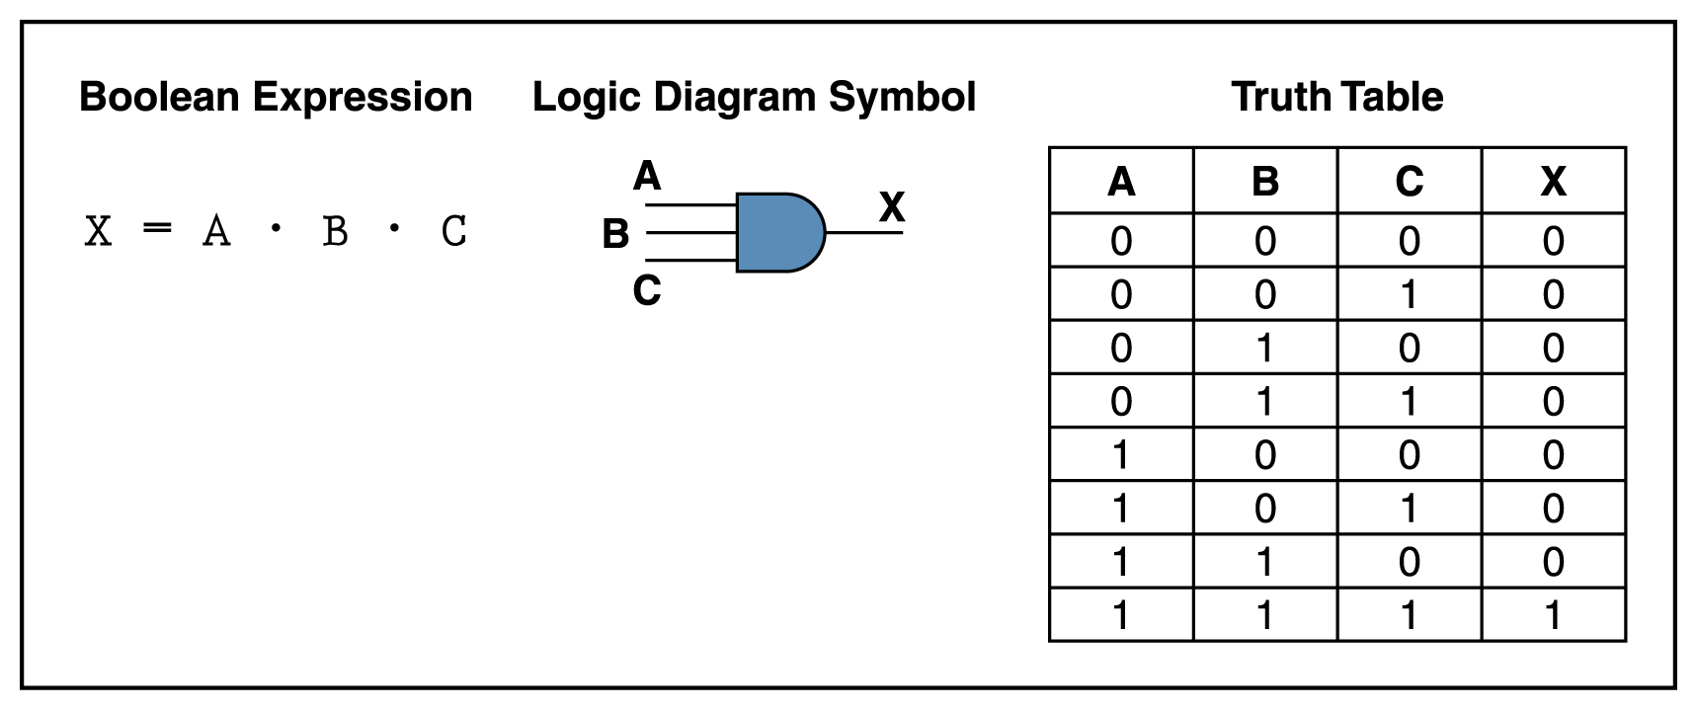
Gates with More Inputs
Gates can be designed to accept three or more input values
A three-input AND gate, for example, produces an output of 1 only if all input values are 1
Figure 4.7 Various representations of a three-input AND gate

Slide 18
Constructing Gates
A transistor is a device that acts, depending on the voltage level of an input signal, either as a wire that conducts electricity or as a resistor that blocks the flow of electricity
A transistor has no moving parts, yet acts like a switch
It is made of a semiconductor material, which is neither a particularly good conductor of electricity, such as copper, nor a particularly good insulator, such as rubber

Slide 19
Circuits
Two general categories
In a combinational circuit, the input values explicitly determine the output
In a sequential circuit, the output is a function of the input values as well as the existing state of the circuit
As with gates, we can describe the operations of entire circuits using three notations
Boolean expressions
logic diagrams
truth tables

Slide 20
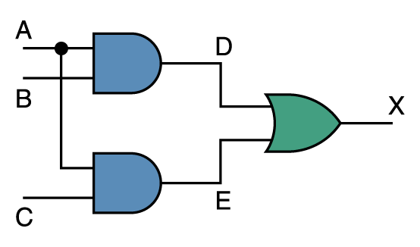
Combinational Circuits
Gates are combined into circuits by using the output of one gate as the input for another
Page 99

Slide 21
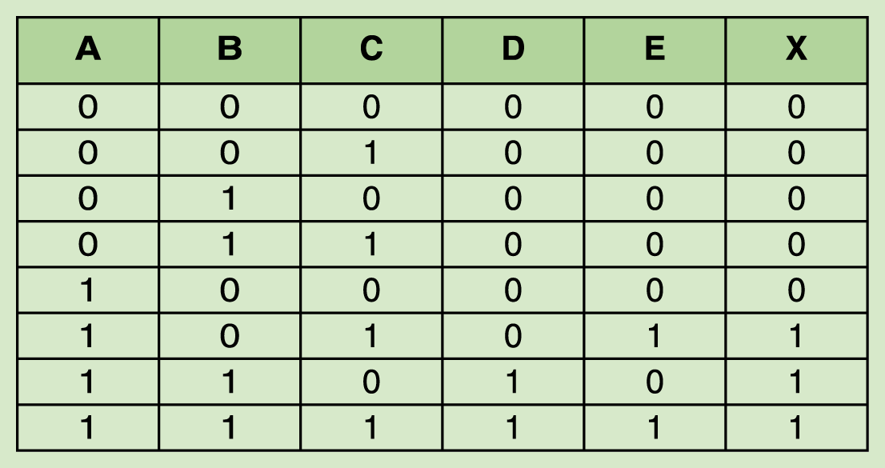
Combinational Circuits
Page 100
Because there are three inputs to this circuit, eight rows are required to describe all possible input combinations
This same circuit using Boolean algebra:
(AB + AC)

Slide 22
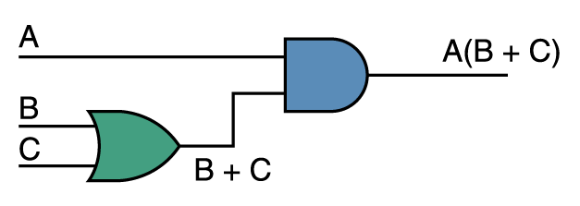
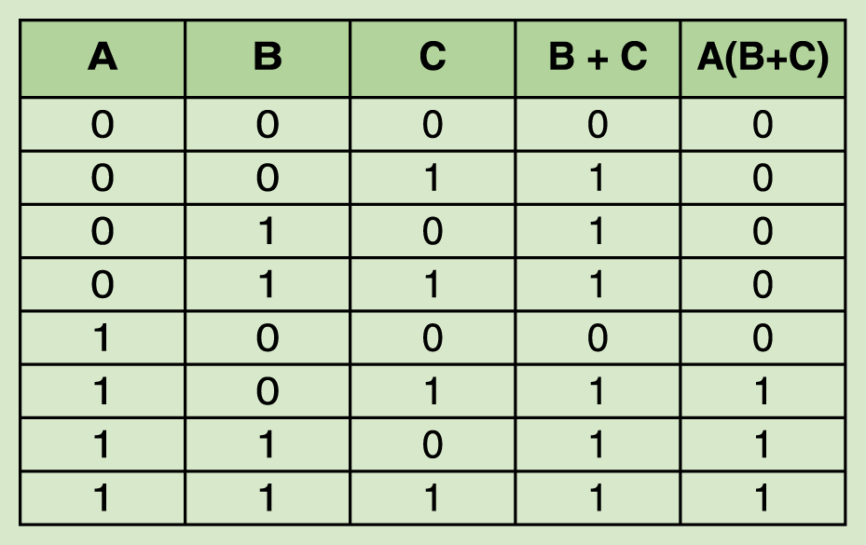
Now let’s go the other way; let’s take a Boolean expression and draw
Consider the following Boolean expression: A(B + C)
Page 100
Page 101
Now compare the final result column in this truth table to the truth table for the previous example
They are identical

Slide 23
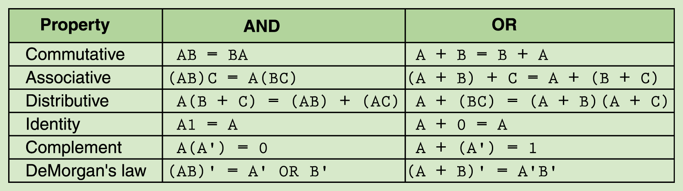
Properties of Boolean Algebra
Page 101
Notes:
Here's an approximate order I do in such a class:
* Have people assemble a simple OR gate, with two switches and one
output bulb. (this is to get used to the software)
* Have people assemble a 3-way OR gate, and play with the
combinations.
* Have people build verify some identities by using the input
switches to simultaneously feed both circuits, each with a
separate lightbulb.
-- A(B+C) == (AB) + (AC)
-- (AB)' = A' + B'
* Sometimes, I have them load my half-adder, and I discuss it a bit
while they play with it. Possibly even looking at the full-adder.
* Then I switch to sequential cirucits and feedback loops.
-- first looking at feedback.dat
-- then looking at feedback2.dat
-- then looking at SRlatch.dat
I have some other premade circuits available as well if you want
(e.g. a multiplexor, a latch). But I'm not sure whether to make time
for them.

Slide 24
Adders
At the digital logic level, addition is performed in binary
Addition operations are carried out by special circuits called, appropriately, adders

Slide 25
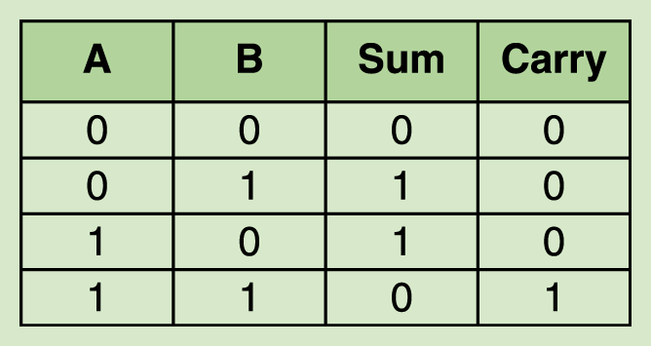
Adders
The result of adding two binary digits could produce a carry value
Recall that 1 + 1 = 10 in base two
A circuit that computes the sum of two bits and produces the correct carry bit is called a half adder
Page 103

Slide 26
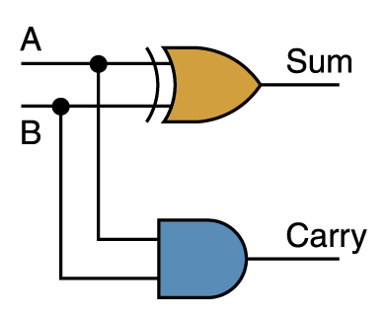
Adders
Circuit diagram representing a half adder
Two Boolean expressions:
sum = A ⊕ B
carry = AB
Page 103

Slide 27
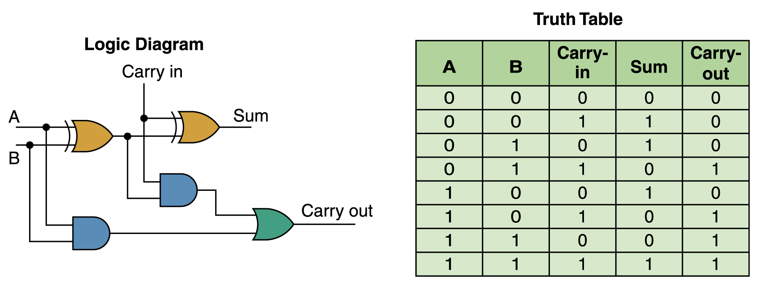
Adders
A circuit called a full adder takes the carry-in value into account
Figure 4.10 A full adder

Slide 28
Multiplexers
Multiplexer is a general circuit that produces a single output signal
The output is equal to one of several input signals to the circuit
The multiplexer selects which input signal is used as an output signal based on the value represented by a few more input signals, called select signals or select control lines

Slide 29
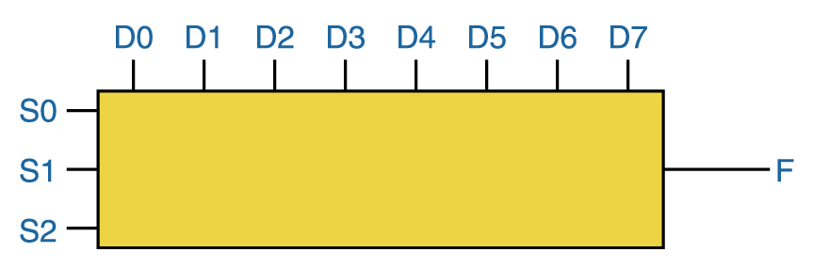
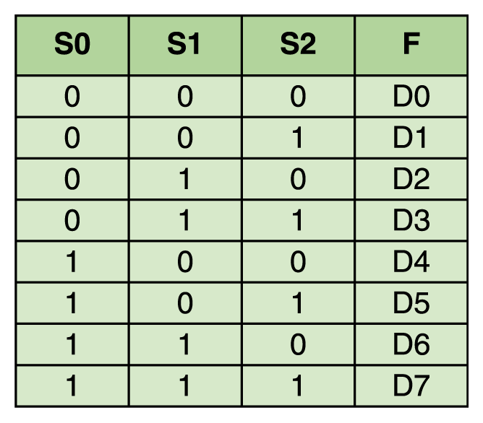
Multiplexers
The control lines S0, S1, and S2 determine which of eight other input lines (D0 through D7) are routed to the output (F)
Figure 4.11 A block diagram of a multiplexer with three select control lines
Page 105

Slide 31
Circuits as Memory
Digital circuits can be used to store information
These circuits form a sequential circuit, because the output of the circuit is also used as input to the circuit

Slide 32
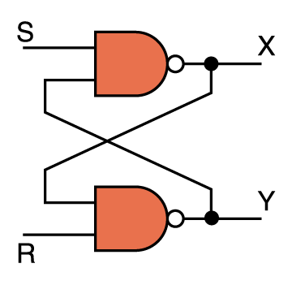
Circuits as Memory
An S-R latch stores a single binary digit (1 or 0)
There are several ways an S-R latch circuit could be designed using various kinds of gates
Figure 4.12 An S-R latch

Slide 33
Circuits as Memory
The design of this circuit guarantees that the two outputs X and Y are always complements of each other
The value of X at any point in time is considered to be the current state of the circuit
Therefore, if X is 1, the circuit is storing a 1; if X is 0, the circuit is storing a 0
Figure 4.12 An S-R latch

Slide 34
Integrated Circuits
An integrated circuit (also called a chip) is a piece of silicon on which multiple gates have been embedded
These silicon pieces are mounted on a plastic or ceramic package with pins along the edges that can be soldered onto circuit boards or inserted into appropriate sockets

Slide 35
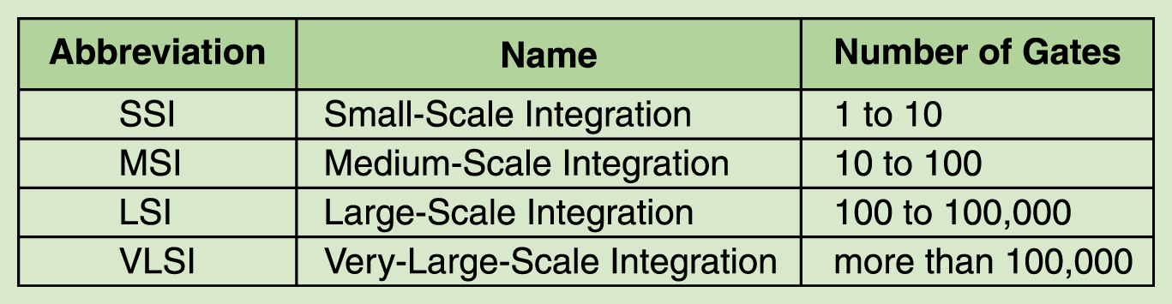
Integrated Circuits
Integrated circuits (IC) are classified by the number of gates contained in them
Page 107

Slide 36
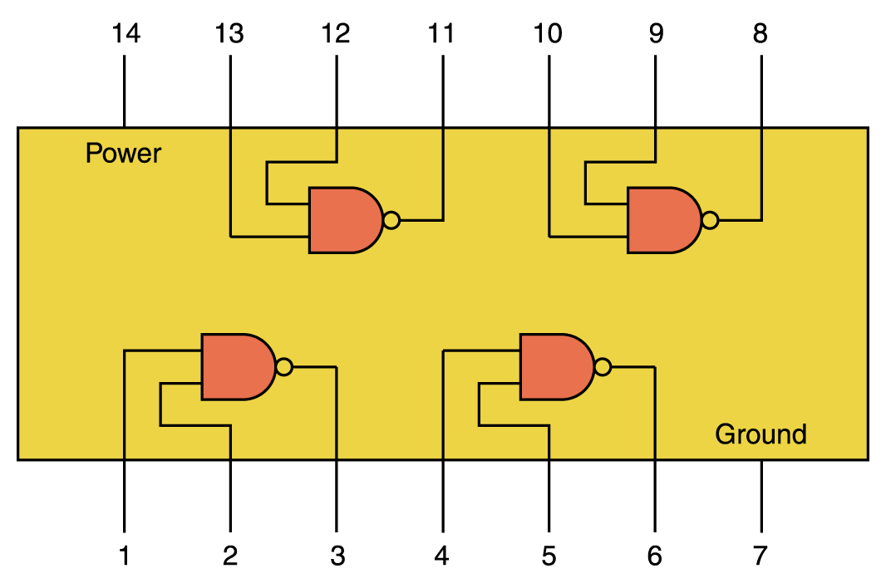
Integrated Circuits
Figure 4.13 An SSI chip contains independent NAND gates

Slide 37
CPU Chips
The most important integrated circuit in any computer is the Central Processing Unit, or CPU
Each CPU chip has a large number of pins through which essentially all communication in a computer system occurs

